Slide 1
Automation Framework (CICD Implementation)
Notes:
IMPORTANT NOTES:
TechReady23 will utilize Windows 10 and the new PowerPoint 2016, as well as PowerPoint 2013 on all event machines. Please build your slides utilizing the appropriate TR23 Template and utilize the version of PowerPoint that works best.
Windows 10 does not support VPN access with a smart card reader. Phone Authentication is the only supported solution. Speakers using VPN in a demo will need to have Phone Authentication pre-configured. Additional details are available here: https://microsoft.sharepoint.com/sites/itweb/securelogon/Pages/FAQ.aspx

Slide 2
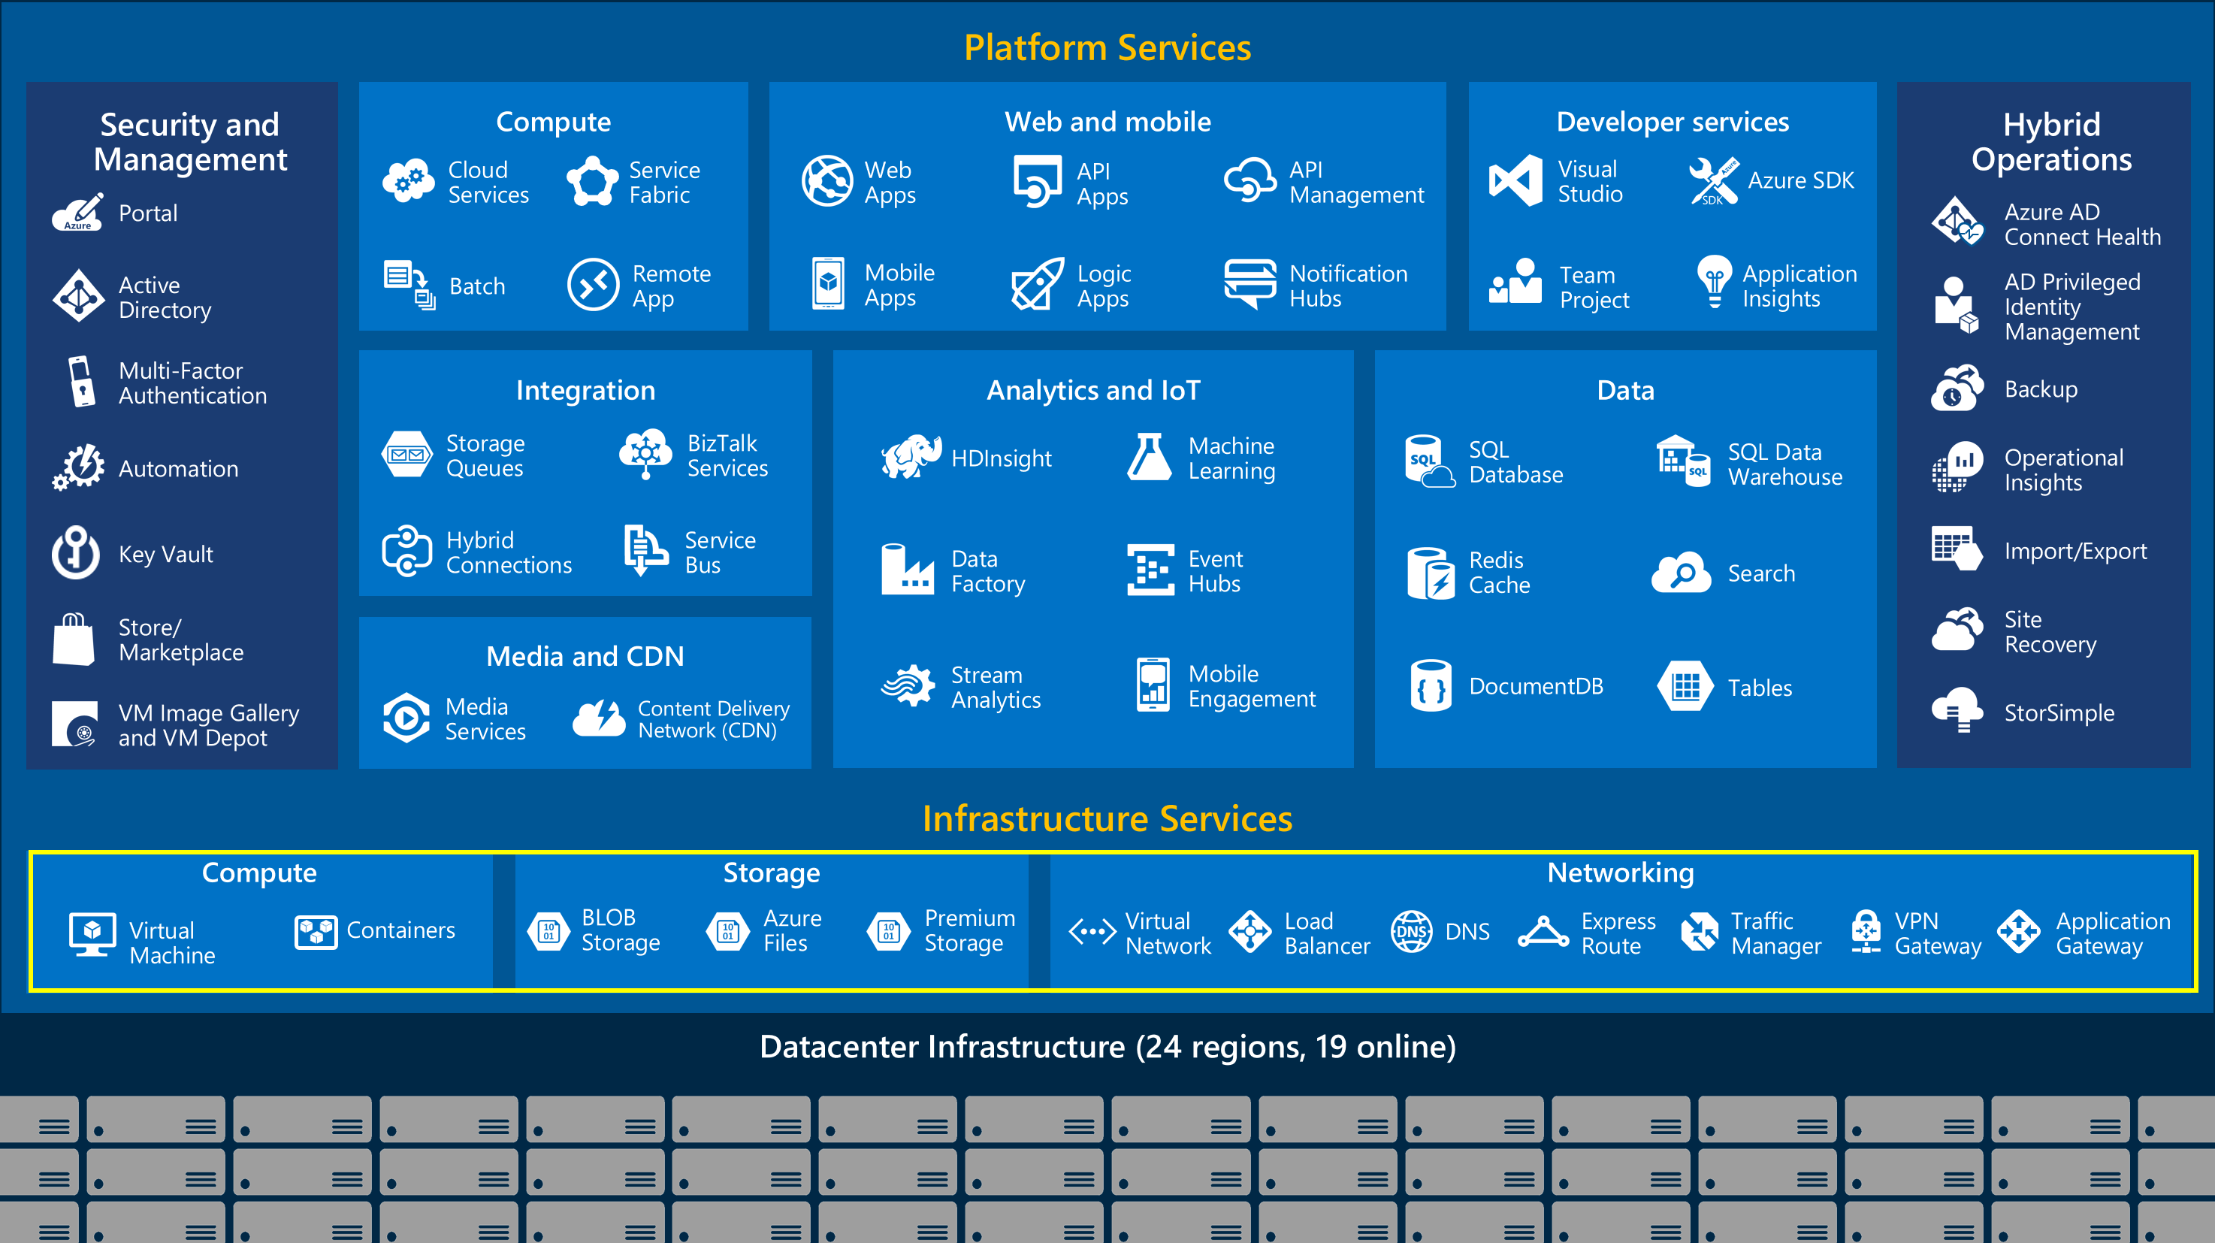

Slide 3
Why Automate?
Types of Apps:
Modern Apps (Generally not Cloud Infrastructure & Management workloads)
Think microservices and containerized application generally utilizing up-stack Azure offerings aka ‘PaaS ‘ implementations
Traditional Apps (Very much not legacy yet!)
Monolith implementation – Multi-tier applications implemented on-prem environments
These are the applications that most of our (CIM) Azure offerings target. For example:
OMS – Monitor these multi-tier Applications
DR – Making these apps resilient and highly available
Lift & Shift – Move these Apps to the cloud without rewriting existing code
Automation:
Automation streamlines and scales the delivery of these applications
Any CICD implementation requires the following functionality:
Orchestration
Infrastructure as Code (Azure ARM Templates / AWS Cloudformation / Terra Other SDKs)
Configuration Management
Monitoring
Notes:
update

Slide 4

Automation Framework Components
Orchestration
Infrastructure as Code
Configuration Management
Monitoring
Set of tooling that strings all the automation scripts
Jenkins
VSTS
GitLab
Deploys out infrastructure resources required support business Apps
Azure ARM Templates
AWS Cloudformation
HashiCorp - Terraform
Configure the resources that have been deployed
Puppet / Chef
DCS
OSS - Python (Fabric)
Add monitoring capability especially if its to go into production
AWS CloudWatch
Azure OMS
Splunk / ELK
Supporting Tools
Underlying technologies that these stages require:
Source Control - GitHub
Package Management - Antifactory
Infrastructure Platform – AWS / Azure

Slide 5


NAT Rules
Public IP (Port 80)
Port 8022 / 8023
User
Azure load balancer (teamcimELB)
Backend
IP Pool (Port 80)
Virtual Network (sshVNET)
PrivateSubnet
OMS
Availability set (teamcimAS)
sshvm1
sshvm2
Managed Disk
sshNIC1
Managed Disk
sshNIC2

